Slide 1

W4201 Advanced Data Analysis
R
4
al
ct
The Investigation on Birth Weight of babies
y
Group17
Su Hang, Xin Shen
Yiwei Sun, Xiaozhuo Wang

Slide 2
Objective
“When are you going have a baby? ”
Older maternal age cause unhealthy babies
Other factors
Notes:
If you are a woman of a certain age, then it’s happened to you many times before. The dreaded question is
Does maternal age really have a huge impact on baby’s health or cause low birth weight ?
What are the factors that contribute to the risk of low birth weight?

Slide 3
Introduction
Data Source
Website: StatCrunch
http://www.statcrunch.com/5.0/shareddata.php?keywords=weight&startlimit=15
Data Description
802 births from state of North Carolina, 12 explanatory variables
Plurality: 0 = not twins, 1 = twins
Baby’s gender: 0 = male, 1= female
Marital: 0 = married, 1 = single
Smoke: 0 = no, 1 = yes
Mature: 0 = no, 1 = yes (>35 yrs)
Race: 0 = non-black, 1= black
Premature: 0 = no, 1 = yes (born < 36 wks)
Mother’s age
Father’s age
Visits: # of medical visits
Gestation
Weight Gained: weight gained during pregnancy

Slide 4
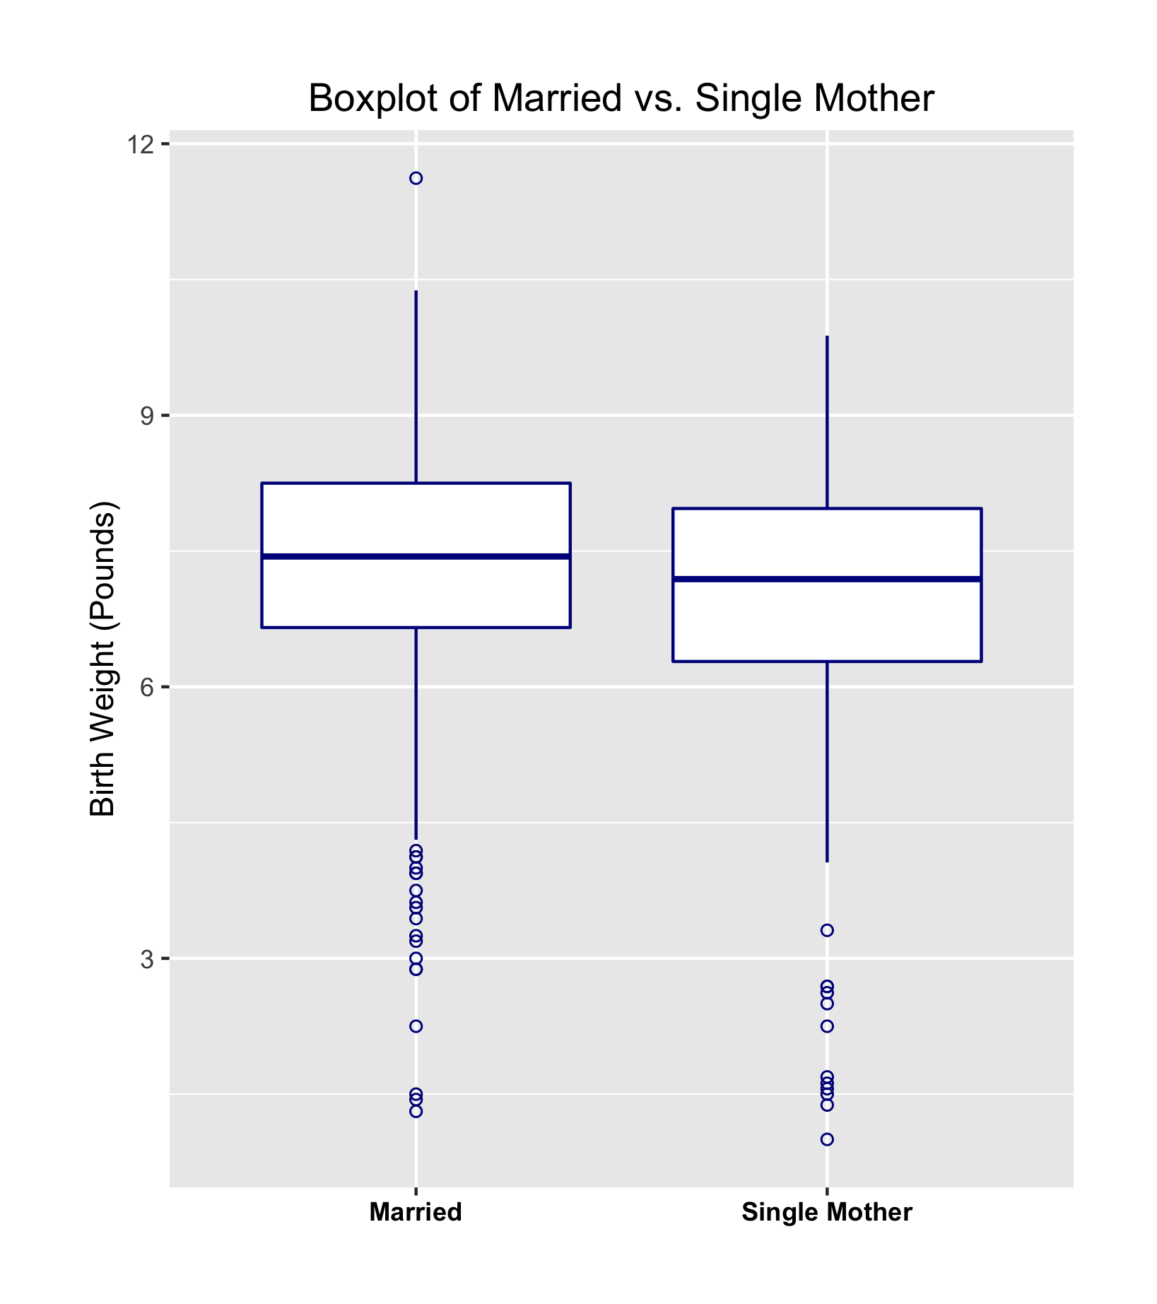
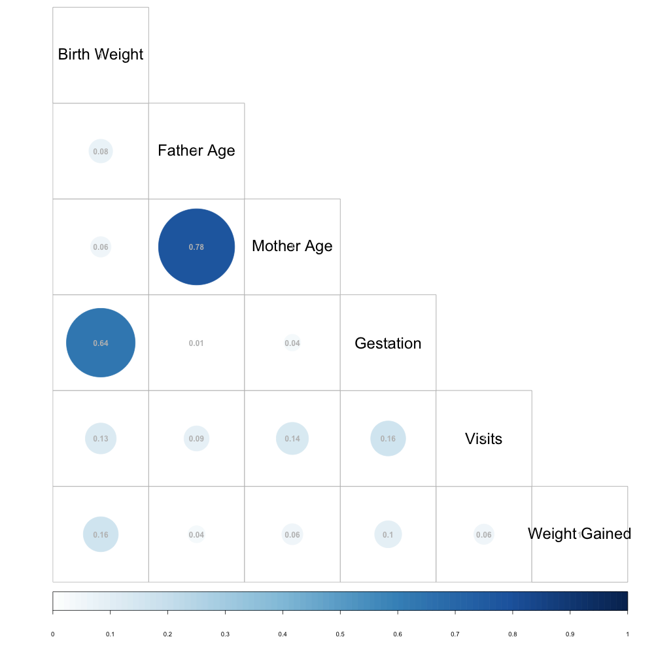
Boxplot & Correlation Plot
Correlation Plot
Rank Sum Test : P – value < 0.01
Notes:
Boxplot, rank sum

Slide 5
Linear Regression Model
Birth Weight = -4.10+0.012*mother’s age+0.29*gestation +0.012*weight gained
-0.30*race-1.39*plural-0.35*baby’s gender-0.20*marital status -0.36*smoke
Adjusted R²: 0.48
VIF (Variance Inflation Factor) test:
mother’s age | gestation | weight gained | race | plural | baby’s gender | martial status | smoke
1.24 | 1.18 | 1.03 | 1.11 | 1.17 | 1.01 | 1.28 | 1.02
Notes:
Boxplot, histogram, rank sum

Slide 6
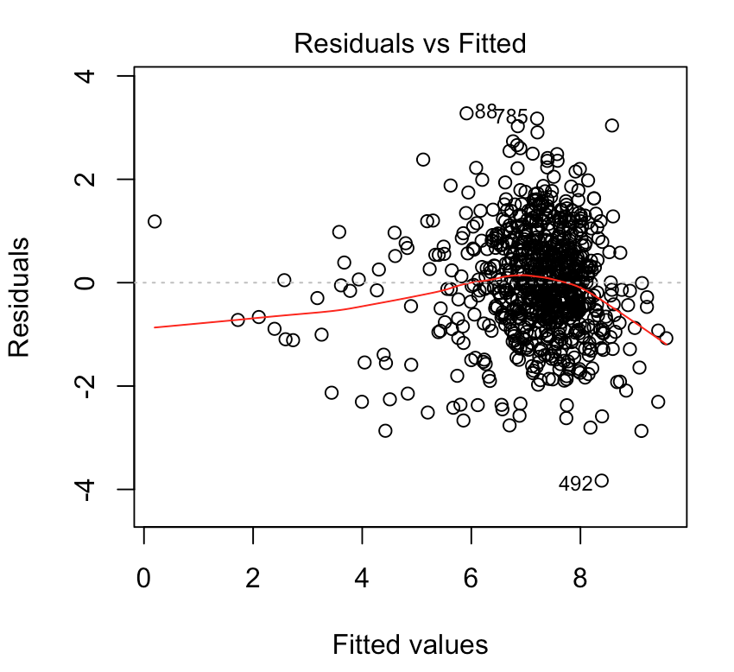
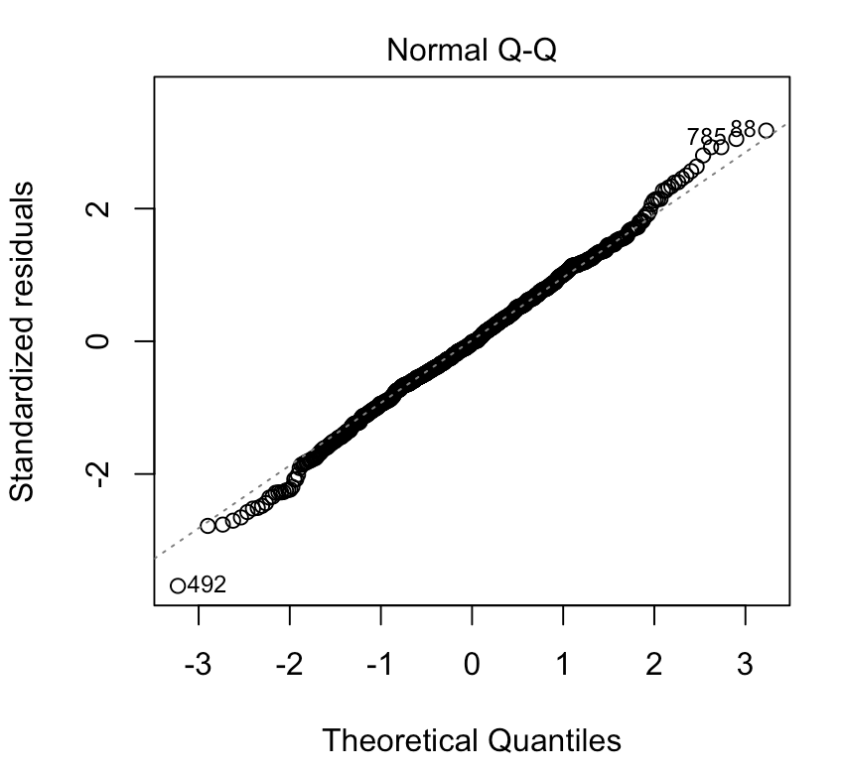
Linear Regression Assumption Check
Notes:
Boxplot, histogram, rank sum

Slide 7
Logistic Model Selection
Low weight: 0 = no, 1 = yes (<5.5 lb)
AIC selected: log(odds)= 20.34 +2.76*plural-0.60*gestation+0.91*marital -0.033*weight gained
BIC selected: log(odds)= 21.64 + 2.11 *plural- 0.64 *gestation
Drop-in deviance: p-value < 0.01
Choose the AIC model
VIF
Plural | Gestation | Weight gained | Marital
1.148 | 1.018 | 1.089 | 1.059
Notes:
Boxplot, histogram, rank sum

Slide 8
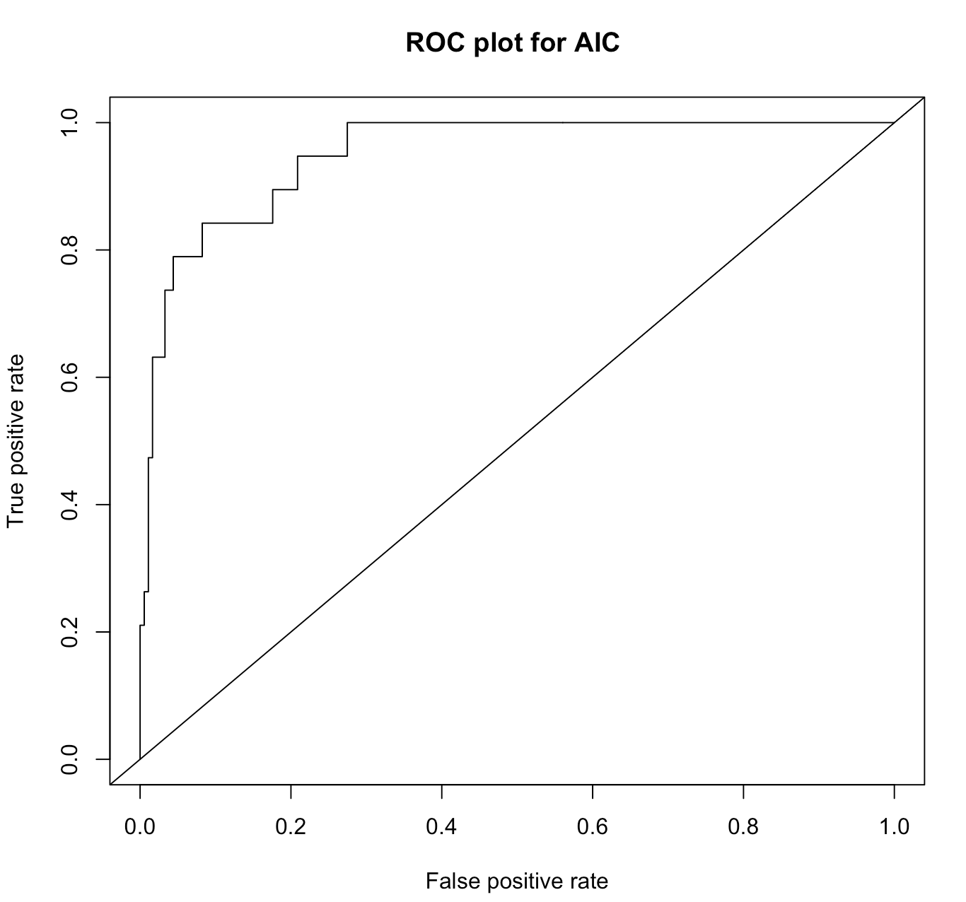
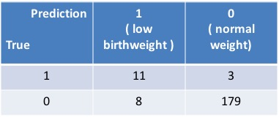
ROC Curve(Receiver Operating Characteristics)
Threshold of the probability = 0.582
True positive rate = 11/14 = 78.6%
Misclassification rate = 11/201 = 5.47%
Notes:
Boxplot, histogram, rank sum

Slide 9
Conclusion
By giving information on weight gained, gestation, plural, marital, smoke, mature, etc, we are able to predict the birth weight of a baby and further to determine if the baby will be healthy or not
It’s a misunderstanding that the older maternal age has a huge impact on babies’ birth weight.
Notes:
Boxplot, histogram, rank sum

Slide 10
Thank You!

